Slide 1
Association between depression and poverty
Daniel lagos
Ana 500
October 23, 2022
https://github.com/danlagos/ANA500-Week-4

Slide 2
Problem statement
Background: Using California Health Interview Survey (CHIS) 2020 to search for an quantify the association between depression and poverty levels after controlling for general health, and current smoking habits in adults in the state of California.
Objective
How does poverty levels affect depression in adults?
What are the effects of general health and smoking habits, and do they interact with poverty levels?
Cam a machine learning model predict depression based on poverty levels after accounting for general health, and smoking habits?

Slide 3
Hypothesis formulation
H₀: There is no statistically significant association between depression and poverty levels after controlling for general health, and current smoking habits
H_{A}: There is a statistically significant association between depression and poverty levels after controlling for general health, and current smoking habits

Slide 4
Top-down program design
Overall Task: Develop Python program that takes CHIS 2020 as input (poverty, general health, smoking habits) and outputs predicted effect on depression levels.
VAR AJ32: captures results of survey question “Feeling depressed in the past 30 days?
VAR AJ32 is categorical, numeric. Coding provided in visualization section
Steps to take
Acquire: identify data set, retrieve data, query data. CHIS has already been selected. Currently in SAS XPT format.
Prepare: analyze codebook, explore and process data using python and discovery from codebook.
Analyze data: select analytical technique, build model
Report: communicate results – not inclusive to code development
Act: apply results, connect results with problem statement – not inclusive to code development

Slide 5
Hierarchy chart
DEPRESSION = CHIS2020DATASET(POVERTY, GENERAL HEALTH, SMOKING)
Main Program( output depression, input CHIS dataset with variables for poverty levels, general health, and current smoking habits)

Slide 6
Flow chart
Start
Load data
Preliminary analysis: ID data set features, statistically describe data
Visualize: Plot each feature against output variable (depression) to understand data
Clean Data: handle missing values

Slide 7
Flow chart
Select Analytical Technique: Neural Network
Model:
keras.models.Sequential()
from Keras library
Input layer: 3 neurons
Hidden layer: 4 layers, 300 neurons. Last layer 100 neurons. Using “relu” for activation function
Output layer: 2 neurons, “softmax” for activation.
Split Data:
Split Data into data frame with dependent variable, and independent variables. Split data into training, validation, and testing data sets

Slide 8
Flow chart
Training and validation:
Use training and validation sets
Loss function: sparse categorical cross entropy
Optimizer: gradient descent
Epochs: 50
Batch size: 32
Test Model:
Predict using test data
Assess Model Performance Metrics:
Loss, accuracy, validation loss, and validation-accuracy
Probability of predictions

Slide 9
Flow chart
Report Results:
Results of Loss, accuracy, validation loss, and validation-accuracy
Plot of Confusion Matrix
Plot of NN
Act:
Produce a set of recommendations

Slide 10
pseudocode
# Start
# STEP 1 Acquire data: from CHIS website
# Import libraries: pandas, NumPy, seaborn, matplotlib
# Read dataset: import data. Must read in SAS XPT file into Python
#STEP 2: Prepare – conduct analysis of codebook – identify appropriate variables, and determine structure
# read data: data.head(), data.info()
# Format data: create new data set with appropriate variables–
SMOKING, AB1 (GEN_HEALTH), POVLL (POVERTY), AJ32 (DEPRESSION)
Esnure DEPRESSION is binary.
Coding: 1 = Depressed, 2 = not-depressed

Slide 11
pseudocode
# Remove inappropriate values – AJ32(Variable for depression) contains value of -2 (means proxy skipped). Not applicable, remove.
# Visualization: make histograms, scatter plots and bar charts, use as appropriate.
# STEP 3: Analyze
# Create two new data sets, one that contains Var DEPRESSION (Y data frame), the other that contains POVERTY, GEN_HEALTH, SMOKING (X data frame)
# Further separate into testing and training data frames (Y_train, Y_test, X_train, X_test)

Slide 12
pseudocode
Train classifier
Max leaf node = 10
Max depth = 5
Criterion = entropy, classifiers based on entropy are better with nonbinary categorical variables as compared to gini index.
Predict on test data
Assess
Accuracy score
Precision score
Recall Score
Plot of decision tree
Plot of feature importance’s – to determine how algorithm weights the importance of each variable.

Slide 13
Acquire
Data set was acquired via CHIS website (https://healthpolicy.ucla.edu/chis/data/pages/getchisdata.aspx). This is a well respected and well cited survey repository that conducts surveys to delve into California's public health issues.
CHIS website proved extensive codebook to assist in analysis and will be relied upon for the data preparation of this project.

Slide 14
prepare
Codebook identifies AJ32, variable for depression with value of -2, meaning proxy missing.
All other variables are categorical numeric

Slide 15
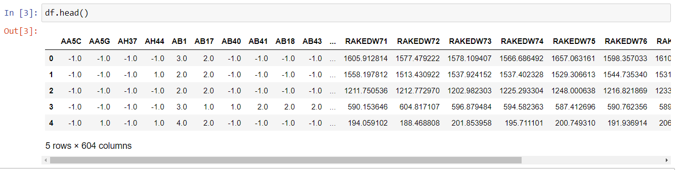
prepare

Slide 16
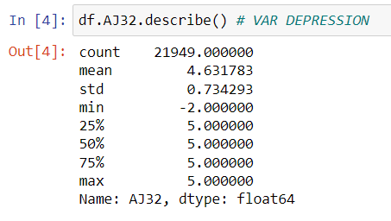
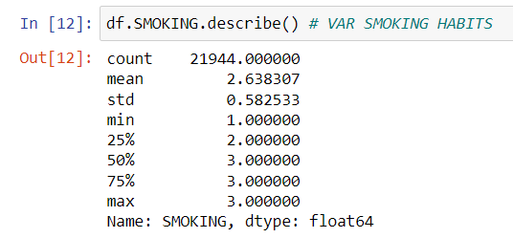
prepare
Confirming that no other variables contain unusable values. AJ32 with values of -2

Slide 17
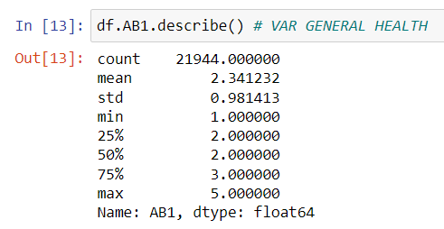
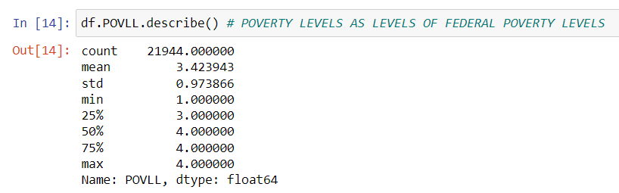
PREPARE
Confirming that no other variables contain unusable values

Slide 18
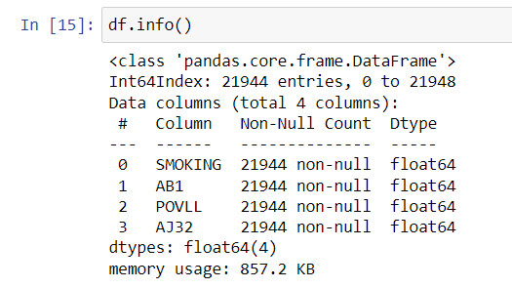
PREPARE
Confirming lack of missing values

Slide 19
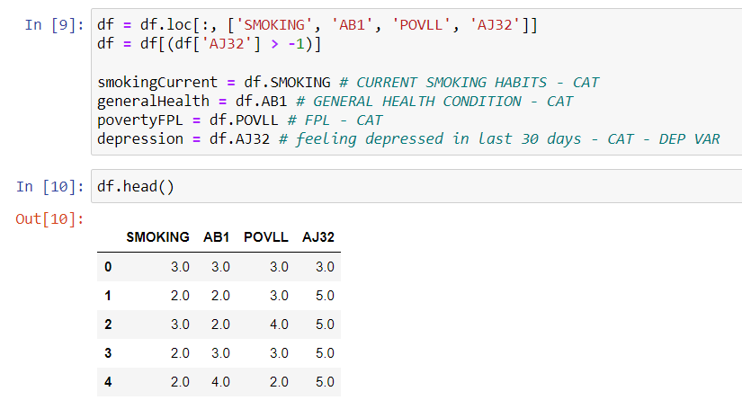
prepare
Clean data

Slide 20

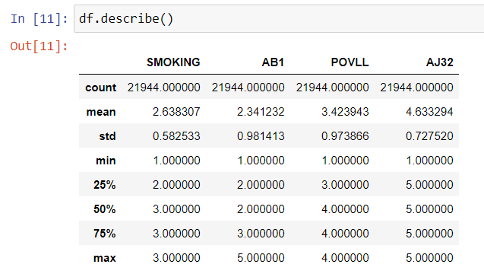
prepare
Original Data set: Confirming data set is clean: all values over 0, n= 21,944, devoid of variables not in use.

Slide 21
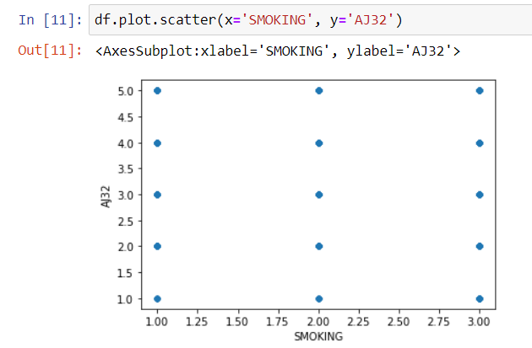
Prepare - visualization
After conducting data.hist(), data.scatter() and data.plot.box() it has been determined that scatter plots are inappropriate: example of output of scatter plot for smoking vs depression levels, below. All other scatter plots provide similar results, and not insightful, therefore not used.

Slide 22
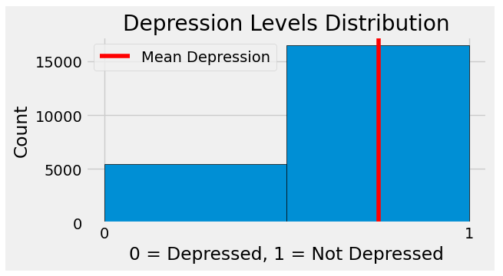
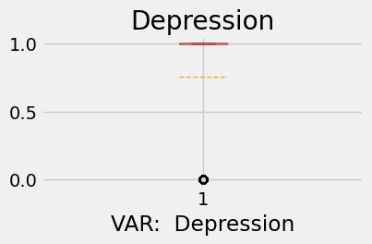
Prepare - visualization
Histogram of dependent variable DEPRESSION. Majority of observation “not-depressed” compared to “depressed”.
AJ32 question: Feeling depressed in the past 30 days?
Changed label of AJ32 to DEPRESSION.
Coding:
0 = Depressed
1 = Not-Depressed

Slide 23
Prepare - visualization
Observations - DEPRESSION: Very difficult to determine much from the box plot. This may be because in the histogram it appears as if there are relatively few people that are depressed compared to those that are not depressed.
Histogram shows left skew, meaning the distribution is not normal. Need to keep this in mind if using an algorithm that assumes normal data.

Slide 24
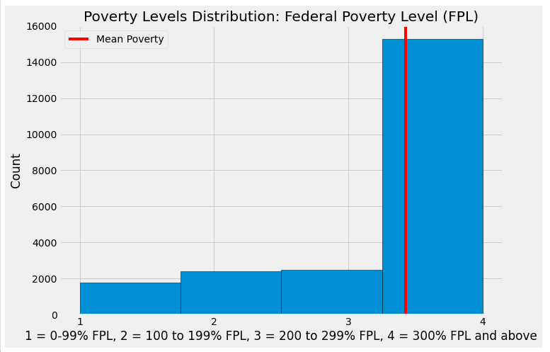
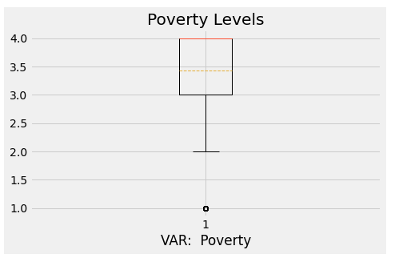
Prepare - visualization
Histogram & Boxplot of POVERTY,. Left Skew.
Federal Poverty level (FPL)
Coding
1 = 0-99% FPL
2 = 100 to 199% FPL
3 = 200 to 299% FPL
4 = 300% FPL and above

Slide 25
Prepare – visualization
Observations – POVERTY: Distribution is not normal. Merely pointing out if an algorithm is used that assumes normal distribution.
Histogram and boxplot confirms skew, confirming lack of normality in distribution
Income is generally ordinal, because poverty levels is based on Federal Poverty Levels, which is a measure of income, this distribution may have an ordinal component. This may determine the type of algorithm, or may require specific testing.

Slide 26
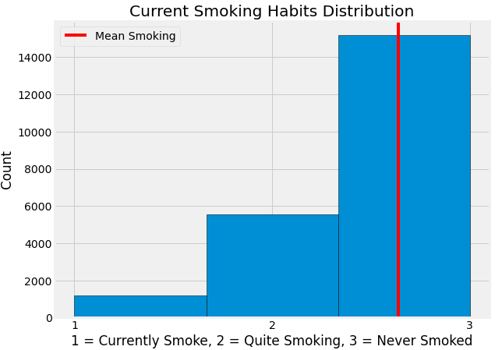
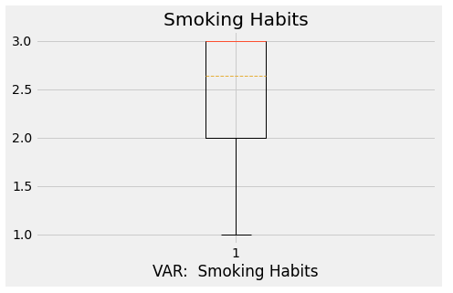
Prepare - visualization
Histogram & Boxplot of SMOKING. Left Skew.
Current smoking habits
Coding
1 = currently smokes
2 = quit smoking
3 = never smoked regularly

Slide 27
Prepare – visualization
Observations – SMOKING: As before, histogram and box plot shows left skew. This is not as important as this is not out exposure variable.

Slide 28
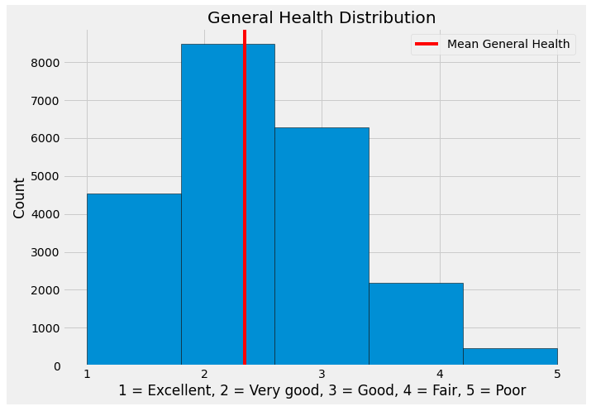
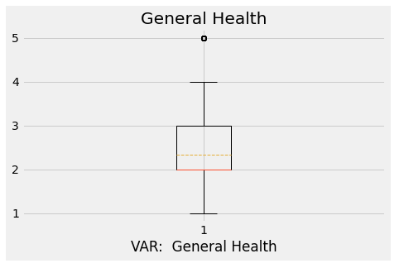
Prepare - visualization
Histogram & Boxplot GENERAL HEALTH, either right skew or might be normal. Difficult to determine.
General Health Condition
Coding
1 = excellent
2 = very good
3 = good
4 = fair
5 = poor

Slide 29
Prepare – visualization
Observations – GENERAL HEALTH: Boxplot and Histogram show that distribution may be normal.

Slide 30
Prepare – visualization
General Observations based on visualizations We are not too concerned about possible lack of normal distributions to the data. We only worry about this if using an algorithm that requires normal distribution. Right now, the possible lack of normality is merely noted. We only need to act upon this if the algorithm used calls for data with normal distributions.
POVERTY may be ordinal. Again, this is not a problem right now, but must be noted when determining the type of algorithm to use.
N = 21,944: This should be sufficient to run an analysis.
All our data is categorical. It may make sense to transform the data into binary forms to simplify the model and reduce computational power. However, there are only 4 variables in total, with 3 to 4 levels. The resulting model, and computational power required to train model may not be that complex. For now, no changes will be made to structure of data.

Slide 31
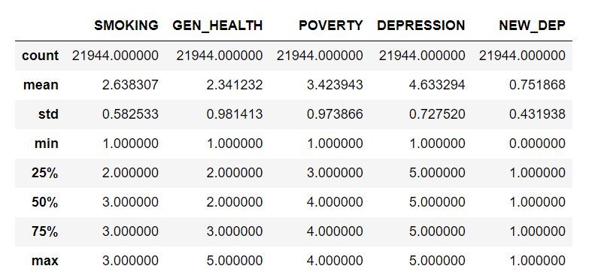
Prepare
Actions taken:
Before Analyze phase was conducted, variables were renamed so that the variable names were less ambiguous.
Var DEPRESSION was changed to a binary structure
If DEPRESSION = 5 then NEW_DEP = 1 (not depressed)
If DEPRESSION <= 5 then NEW_DEP = 0 (depressed)

Slide 32
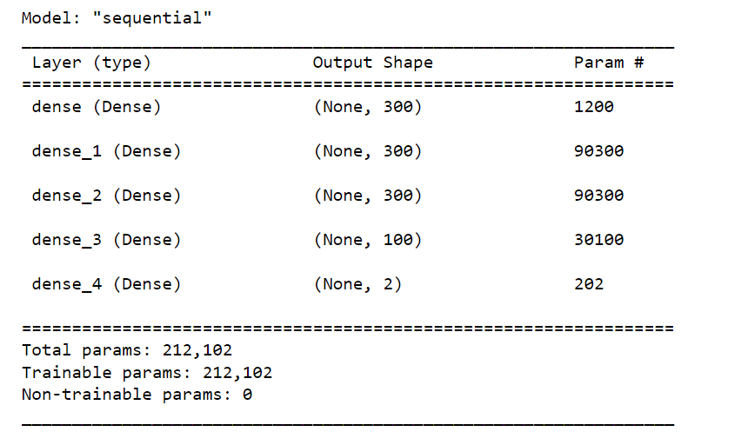
Analyze
This is a classification problem with labels, thus supervised type of ML. Neural network used, with the following hyperparameters for layers
Input layer: 3 neurons
Hidden layers: 4 layers, 300 neurons for all layers except for the last, contain 100 neurons. Activation function to be “relu” for all layers
Output layer: 2 neurons, one for each class within var NEW_DEP. Activation function to be “softmax”
Other hyperparameters.
Loss: sparse categorical cross entropy
Optimizer: gradient descent
Epochs: 50
Batch size: 32

Slide 33

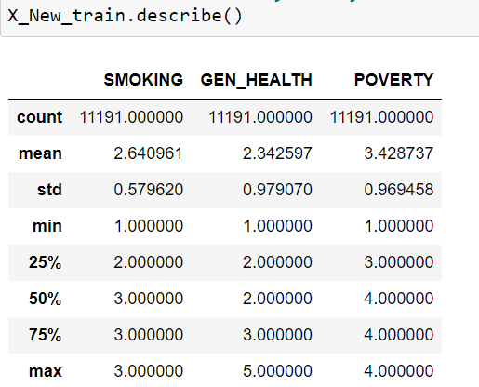
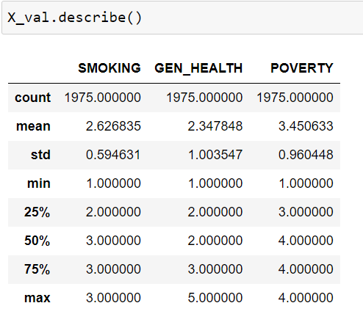
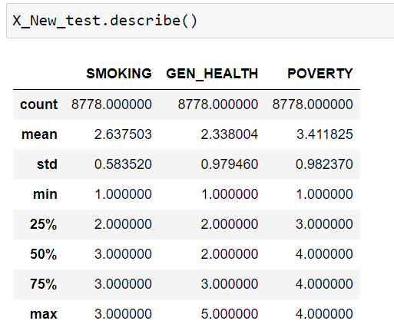
Analyze
Independent variables were split in the manner Shown above

Slide 34
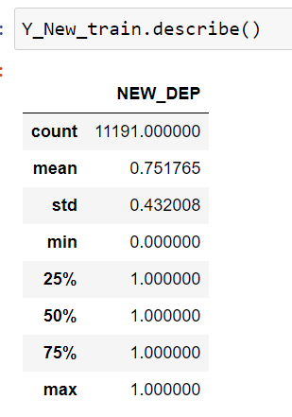
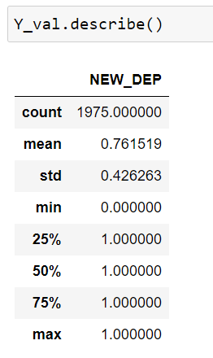
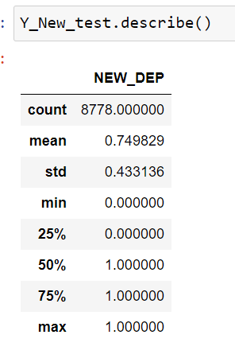
Analyze
Dependent variable was split in the manner Shown above

Slide 35
Analyze
After conducting training and validation of neural network, loss accuracy, validation loss, and validation accuracy metrics were produced.
Plot of neural network is based on training and validation set.
Evaluation was conducted on test set, producing loss and accuracy scores as well as confusion matrix.
Note: originally this network was conducted with two hidden layers. In an attempt to optimize, 2 hidden layers were added, increasing the number of hidden layers to 4.. This presentation reports on results with additional layers, as there are no significant differences.
Results in the next section.

Slide 36
Report
Training scores:
Loss: 53.88%
Accuracy: 75.26%
Val loss: 52.75%
Val accuracy: 76.35%
Testing scores:
Loss: 54.63%
Accuracy: 75.09%

Slide 37
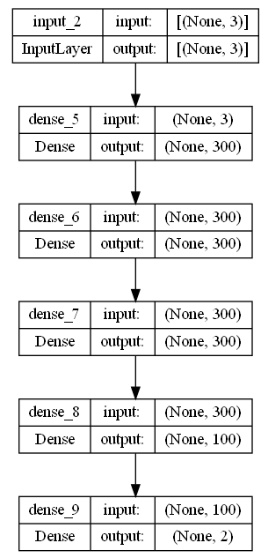
Report
Plot of NN: There is very little complexity.
As a reminder, this plot is based on training and validation sets.

Slide 38
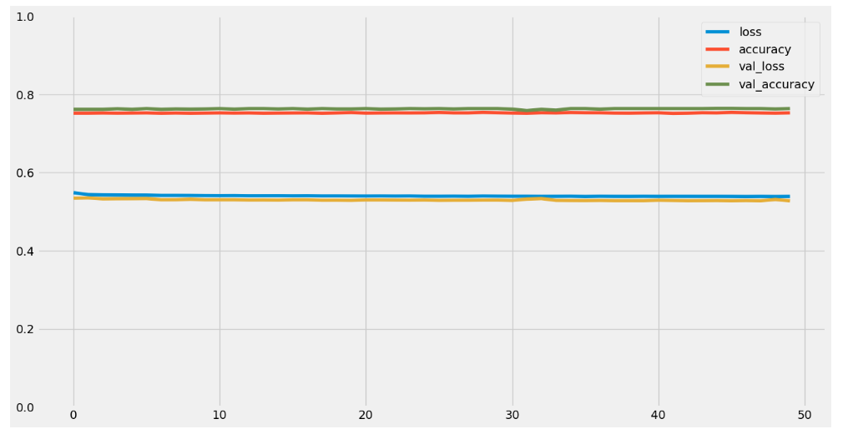
Report
Model performance chart
X-axis indicates epochs
Y-axis indicates score
We have two sets of horizontal lines, indicating no gain after initial epoch.
Network was unable to improve scores after 50 epochs

Slide 39
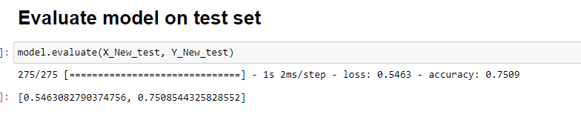
Report
Loss: 54.63%, accuracy: 75.10%, results similar to training scores

Slide 40
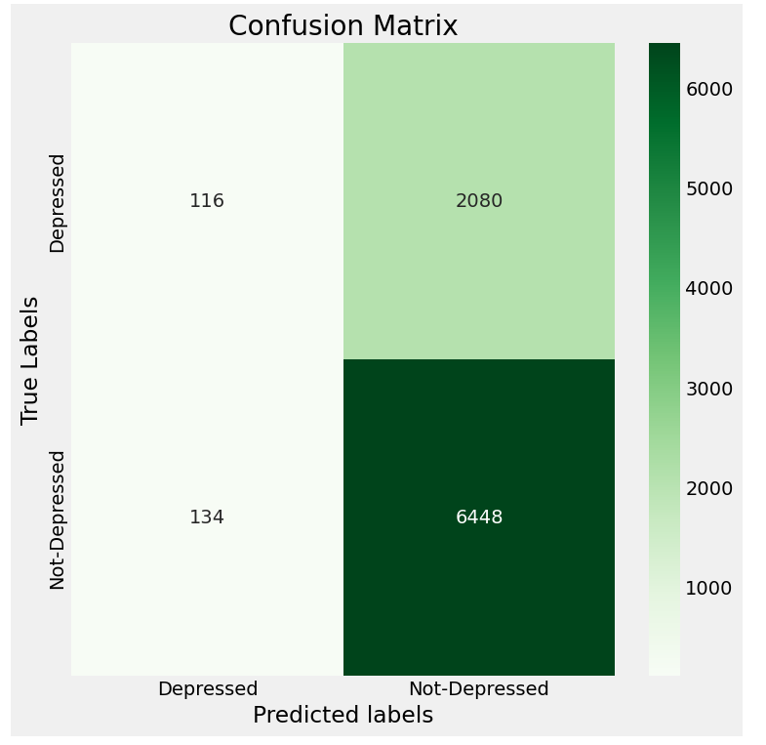
Report
Confusion matrix plot: We would expect to see the upper left box to be a dark green if the model were correctly predicting “Depressed”
We see that network is mis-categorizing “depressed” as “not-depressed”
Network is correctly categorizing “not-depressed”

Slide 41
Act
Low accuracy scores of 75%, large misclassification of “depressed” as “not-depressed.” In the neural network plot we see that there is very little complexity. All these factors seem to indicate that the three variables are not sufficient in predicting depression.
If we only consider these results, we must conclude that POVERTY, GEN_HEALTH, and SMOKING do not adequately predict DEPRESSION, forcing us to accept H_0.
Hyperparameters were adjusted by adding more hidden layers, this did not produce significant changes. Neither the model nor the hyperparameters are the issue.
It should be noted that a decision tree was previously conducted on the same data and variables. Results here are consistent with results of decision tree. This further confirms that the analytical technique is not the issue with the mis-classifications weakening the model.
Also, there is a large body of published research that shows strong connections with depression and poverty. We cannot eliminate this variable, unless we ignore publish research.
It must be further noted that the model is correctly predicting “not-depressed.” We can hypothesize that this is either an accident or that the model requires more complexity by adding more variables.

Slide 42
Act
Two courses of action are recommended:
Conduct a thorough test on neural networks hyper-parameters, to confirm that changing these will not provide much more improvement to model. Given that we have added to the complexity of the nueral network by adding two hidden layers with 300 neurons each, I do not expect to find much improvement by this course of action. This is merely recommended to be systematic in testing. Recommend using another NN algorithm to find optimal hyperparameters.
Conduct PCA of original dataset. Objective is to improve prediction power by finding more variables or eliminating current variables. Our main goal is to address misclassification of depressed” vs “not-depressed”

